Slide 1

Incident Reporting
Senior Design Project
10/23/2020
Team Members: Rivata Dutta
Atticus Jones
Ulysses Uribe
Special Thanks to:
Prof. Richard Jullig
Patrick Mantey
Akila De Silva
Rob Wormald
Notes:
an apple open source engienner, our project was based on the his idea at apple

Slide 2
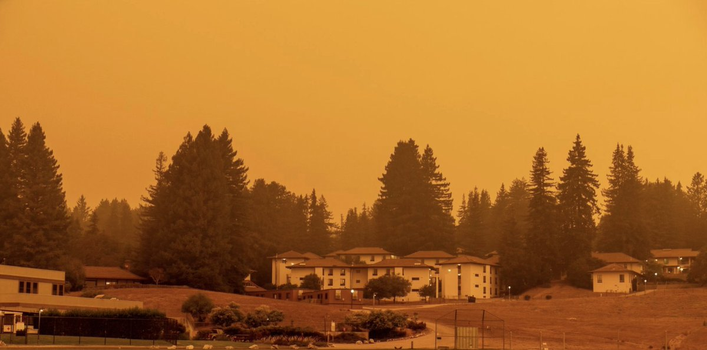
A Panic Highlight in 2020 (OUT OF VERY MANY):
CZU LIGHTNING COMPLEX FIRES
86,509 Acres (mostly in Wilderness)
37 Different Fires
Incorrect Locating of Fires (due to inaccurate reports)
Incorrect Fire Departments dispatched
.How Could This be Prevented?
Notes:
-So 2020’s obviously been a rough year,and I think almost everyone will remember the time our school almost burned down.
- Yeah the czu fires.
-This fire consisted of 37 different subfires in a very large region. Most of these fires were in the wilderness, and could not be located very easliy.
-People would call in and let fire respondants know where they thought they saw a fire.
- Our sponsor relayed a story from an actual fire respondant to us where a whole fire team went up a mountain to see that there was no fire in that forest area. They had to drive all the way back to their base as the fire was not even in their dept location. How could we prevent this?

Slide 3
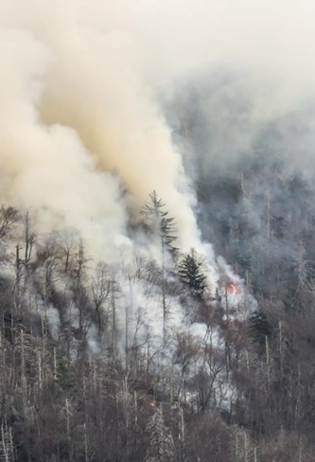
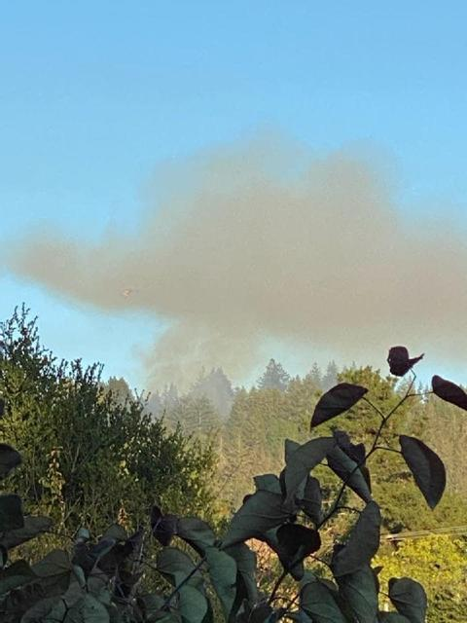
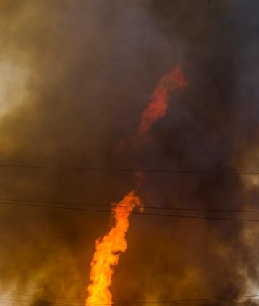
Incident Reporting - Approximate Locations of Fire from Images!
Image pointing South-East
Coordinates: [47.17 S, 101.85 W]
LOCATION OF FIRE
Image pointing North-East.
Coordinates: [46.21 S, 101.86 W]
Image points South-west.
Coordinates: [46.17 S, 100.81 W]
Valuable time could be saved.
Notes:
- So we created an app that approximates a location of fire from images using lthe coordinates of where the image was taken and which direction the image was facing.
- Fire Respondants would be able to use this technology to accurately pinpoint the location of a fire and save valuable time.

Slide 4
Not just beneficial to fire departments, but also community residents!
📍 Residents are not notified about every fire in their area.
💀Panicking not knowing how far the fire is near them.
⚡Could be unaware of the severity or location of fire.
VERSION 1.0
Community-Based App
Stay up to date with current fires in the area
Notes:
-So our app would not just be beneficial to fire departments, but also community residents!
- Residents normally are notified about fires only if is an insane danger to them or if its time to evacuate. Ik i was unaware that the czu fires were 1 mile away from me until the uni notice. If i had the Incident-Reporting app then, I would have known that the fire was a mile away from me much sooner than 24 hours before forced to evacuate in a panic. (CLICK)
-while the app is beneficial for both fire depts and communities, VERSION 1.0 is focused on creating a community based app due to the duration of our development period.

Slide 5
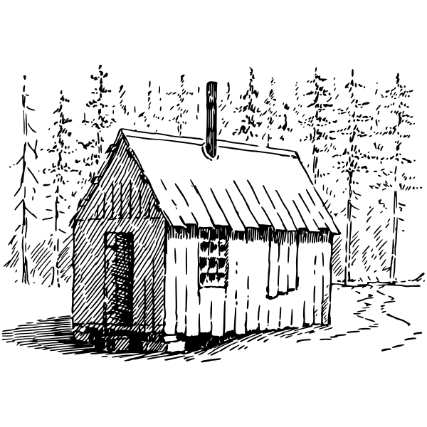
WE RELY ON YOU FOR INFORMATION.
We created a mobile application to help pinpoint current fires in YOUR local area.
TAKE PICTURES of the threat
VIEW INCIDENTS reported by your neighbors
VIEW MAP of potential FIRES in your area
Notes:
Ulysses start -- our app relies on you, the end user for information. Our app can pinpoint fires, in and around your area. With it, you can take pictures of fires, view incidents, reported by your neighbors, and browse through the map to see where fires might be.

Slide 6


Get Location and Sign in
Our App
Notes:
Here, we have a short clip of the app in action…(Play vid) For first time usage, the user enters their desired name to be saved in the app. Next, the users enter a location to be used as their home location, so that they can be notified of fires in their area. And from then on, the user is directed to an option screen where they can choose to view the map that displays the fires information, or go to our in-app camera that is used to take pictures of fires and upload to the database.

Slide 7
UPLOAD PICTURE OF THE INCIDENT
Our App
Notes:
(Play) To upload an image, the user clicks the button to go to our in-app camera... the camera features a compass in the upper right corner that gives users feedback of where their pointing... They can then take a picture… confirm it... upload it... and then they can go to the map to view its location via a dropped pin, and the pinpointed intersection of the fire as well as see the rest of the map and pins in the area.

Slide 8
VIEW MAP
of
REPORTED INCIDENTS & POTENTIAL FIRES
Our App
Notes:
Viewing the map in more detail, the user clicks the button to go to the map, we have a couple pins that represent where the images of a fire were taken, along with some helpful data. Clicking on a pin will show details of the image uploaded, such as time, date, compass direction and the location it was taken. You can follow the direction vectors until it they arrive at the point of intersection, which is the location of the fire. You can also change the map to satellite view in order to see what’s in and around the fire.

Slide 9
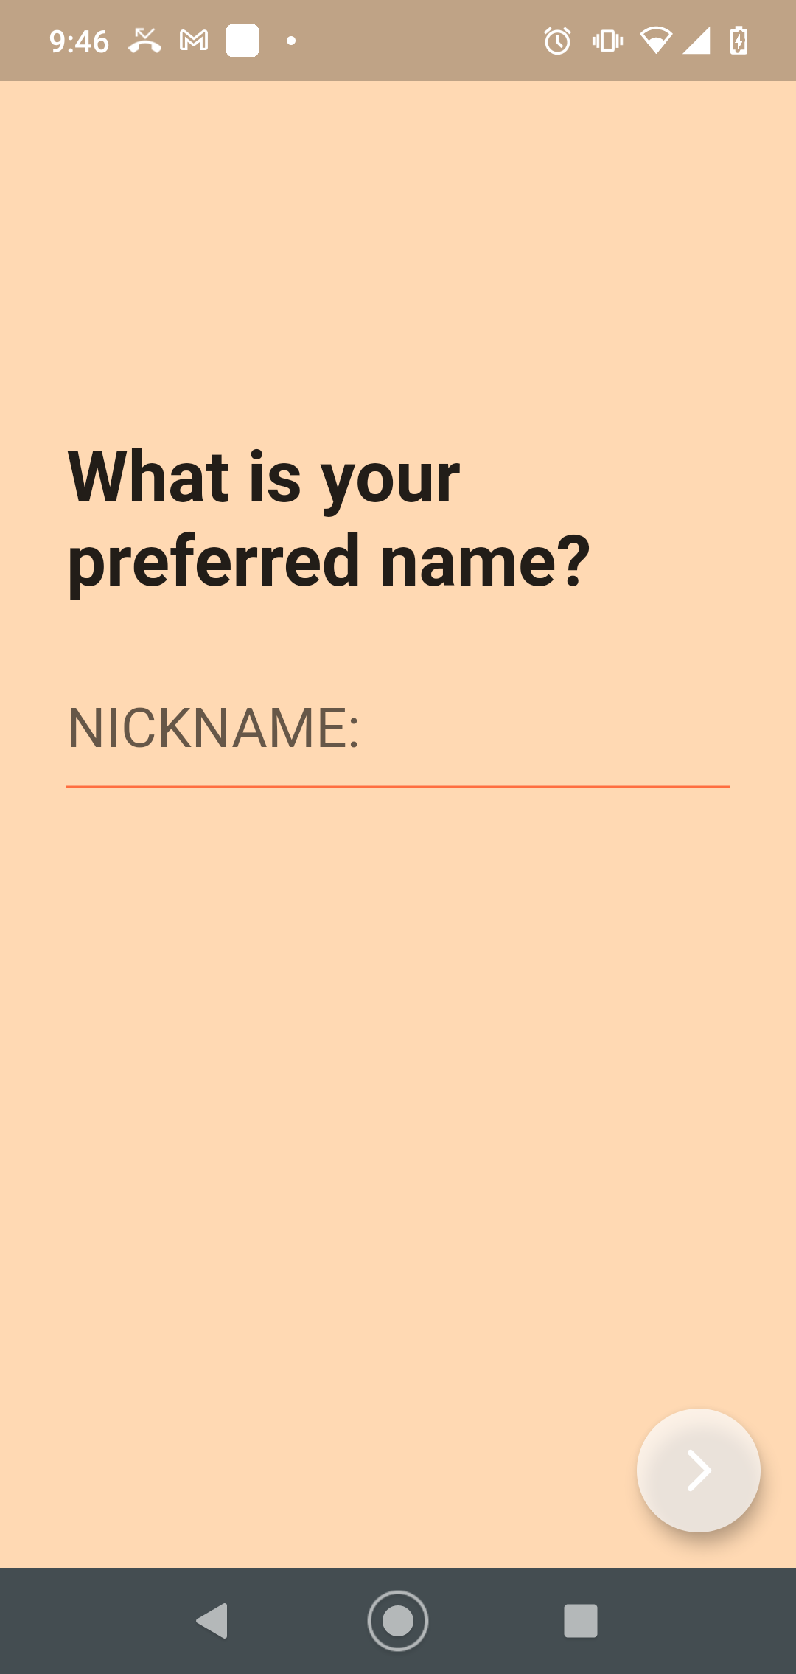
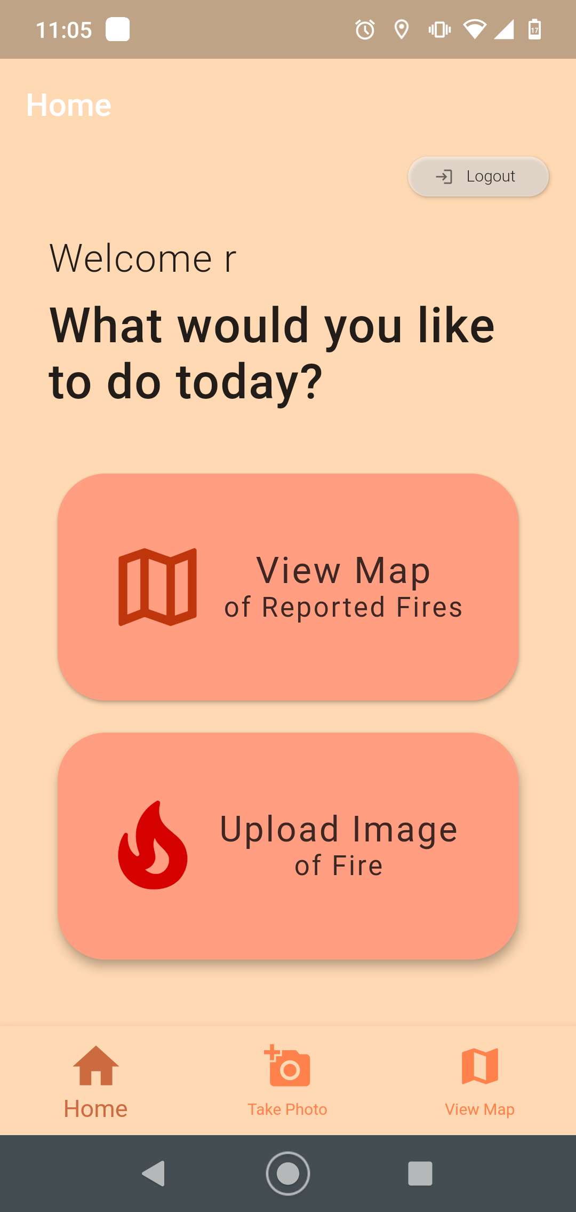
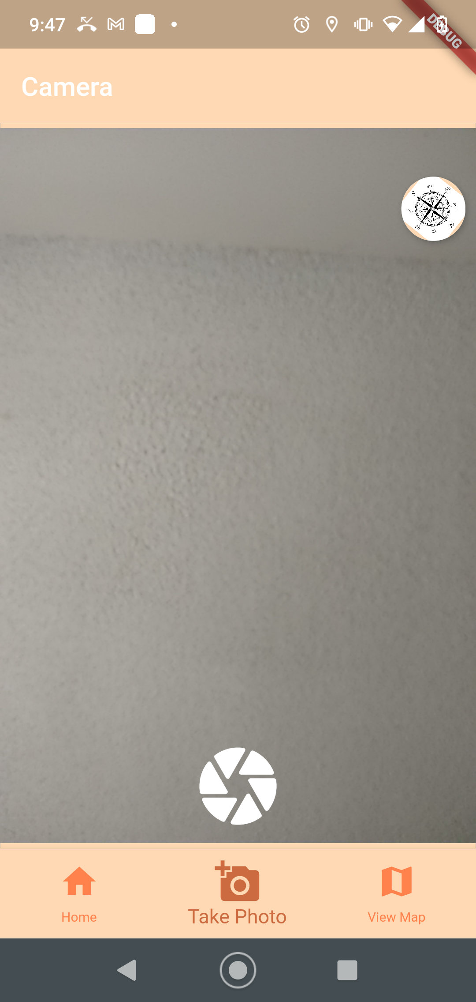
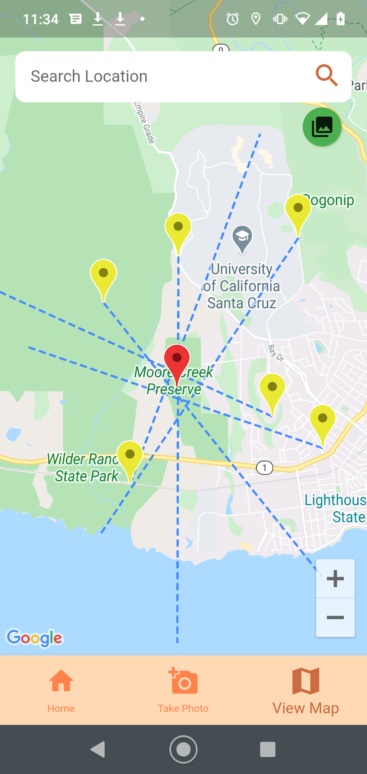
Screenshots of Demo
Our App
Anonymous Login
Homepage
Capture & Upload Image
View Fires & Fire Reports

Slide 10



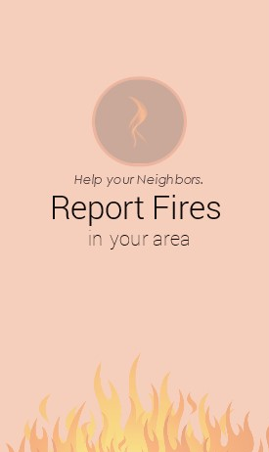

System Architecture
Firebase
database
Flutter & Dart Front-end
App is hosted on Google Cloud Platform. Backend consisted of firebase to store our data and Google API for map features. We designed using JustinMind and implemented it using Flutter. Github was used as our collaborative platform.
Image Upload
Fire Location. Google Maps API.
Final Product
Notes:
We wrote our app with flutter and it’s hosted on Google Cloud Platform. The backend consist of firebase which store’s the data and calculates a fire’s location, this data is then layered on the app with Google API and it’s map features.

Slide 11
How we located INCIDENTS
Find the likely point of incident
01
Capture Data
South-east
[46.17 S, 100.81 W]
02
South-west.
[46.17 S, 100.81 W]
Crowdsource Images
03
Find Intersections
04
Average Intersections
North-east
[46.17 S, 100.81 W]
Notes:
Capture data: Compass Data (heading in degrees 0-360), Location Data (LatLng coordinates)
Crowdsource images by having users upload images/data. more is better. available data, the more accurate we can get
From all of the uploaded data, create vectors and find the points of intersections. [example above]
Last step, find average of all the points of intersection, resulting in a single location that we can use as the approximate point of the fire

Slide 12
CHALLENGES
(Where do we even begin)
Getting started with Flutter. Ten weeks is a short time to create an app on a new platform.
SIMPLIFYING our product. We wanted to make it easy on the user and easy on our end to obtain important location & image data.
Precision on calculating fire location. Right now, we just have an approximate estimate.
Notes:
Challenge to get started with flutter. Before, We were unfamiliar with building mobile applications. We had significant ramp up time.
Simplifying/Defining what we thought was doable in 10 weeks… The whole point of our app is to give our users information that they might not have otherwise.
Precision. Phone compass are not very accurate, there is significant variability in measurements. This can be compensated for by having more users and available data.

Slide 13

Future Release
Distinguish Between Multiple Incidents
Increase Accuracy
Handle Notifications
Increase functionality for First Responders
Notes:
Distinguish Between Multiple Incidents
Right now, our app can’t distinguish between multiple incidents
Add functionality to have ‘Incident Object’
Increase Accuracy
Phone compass’s are not very precise
Have users take 3 pictures and average the compass data for the purpose of smoothing errors
Handle notifications
Don’t want everybody in the area to get alerts on every image uploaded
Send alerts on critical mass, Verification of pictures,
First Responders
down the road, if this technology is proven to be accurate and reliable, give first responders access to aid them.

Slide 14
Thank you.

Slide 15
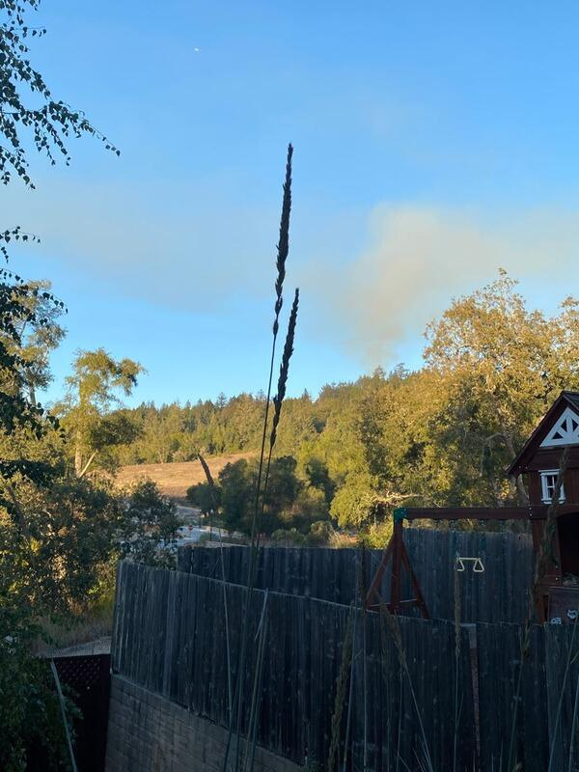
RESOURCES

